Slide 1
Pythagorean n-ples
Dan Kalman
American University
Slides At:
www.dankalman.net
Spring SE Section Meeting
2/28/2025

Slide 2
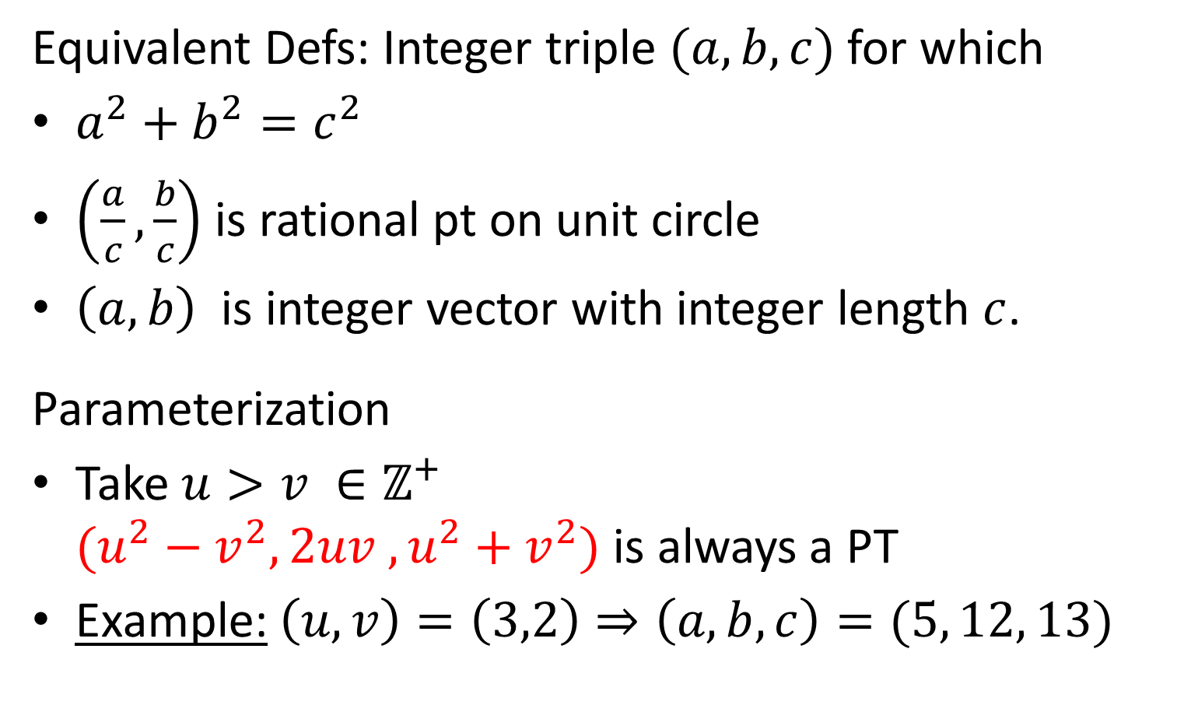
Pythagorean Triples
Equivalent Defs: Integer triple $(a,b,c)$ for which
$a^{2}+b^{2}=c^{2}$
$\left(\frac{a}{c},\frac{b}{c}\right)$ is rational pt on unit circle
$\left(a,b\right)$ is integer vector with integer length $c$.
Parameterization
Take $u>v ∈ℤ^{+}$
$(u^{2}−v^{2}, 2uv ,u^{2}+v^{2})$ is always a PT
Example: $\left(u,v\right)=\left(3,2\right)⇒\left(a, b, c\right)=(5, 12, 13)$

Slide 3
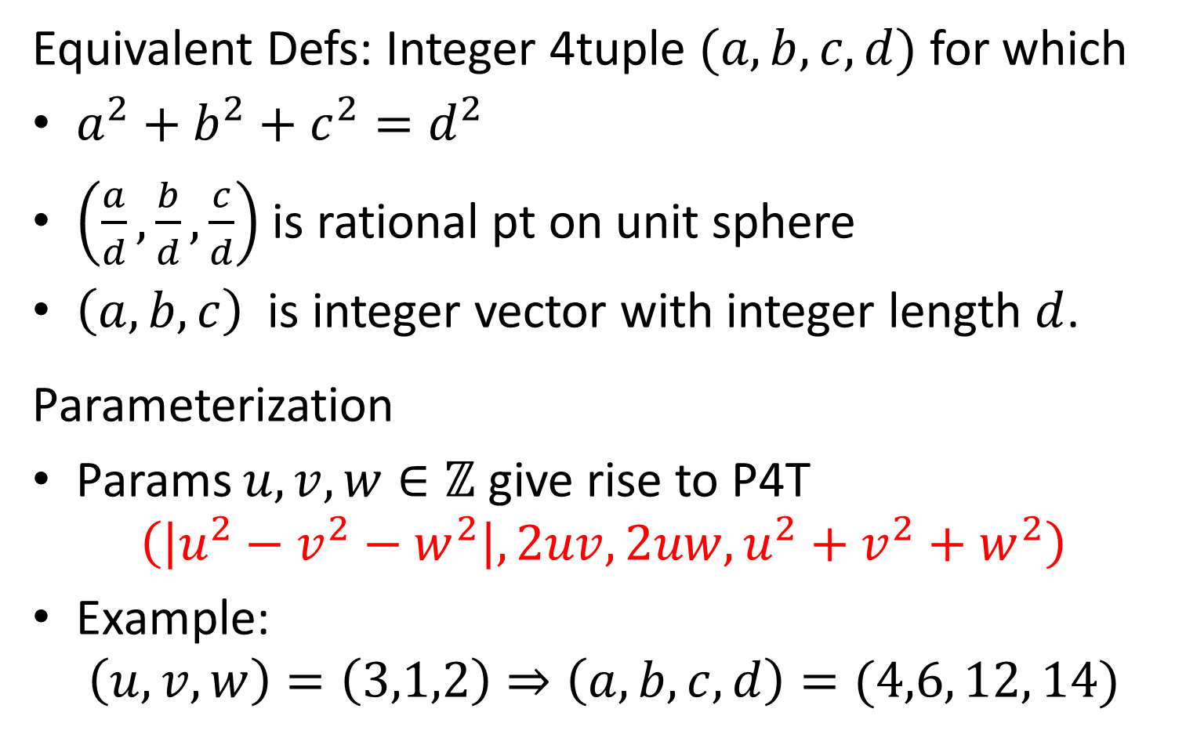
Pythagorean 4‐tuples (P4Ts)
Equivalent Defs: Integer 4tuple $(a,b,c,d)$ for which
$a^{2}+b^{2}+c^{2}=d^{2}$
$\left(\frac{a}{d},\frac{b}{d},\frac{c}{d}\right)$ is rational pt on unit sphere
$\left(a,b, c\right)$ is integer vector with integer length $d$.
Parameterization
Params $u,v,w∈ℤ$ give rise to P4T
$\left(\left|u^{2}−v^{2}−w^{2}\right|, 2uv, 2uw,u^{2}+v^{2}+w^{2}\right)$
Example:
$\left(u,v,w\right)=\left(3,1,2\right)⇒\left(a, b, c,d\right)=(4,6, 12, 14)$
16 + 36 + 144 = 196 = 14²

Slide 4
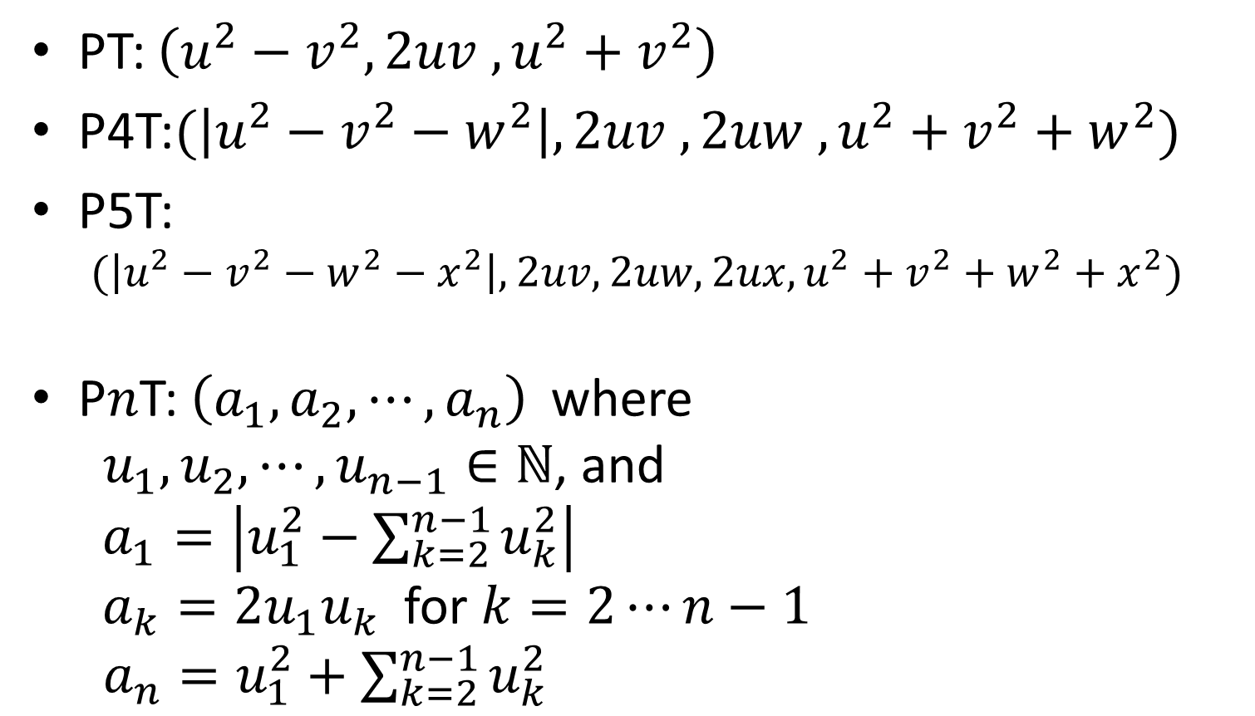
Compare Parameterizations
PT: $\left(u^{2}−v^{2}, 2uv ,u^{2}+v^{2}\right)$
P4T:$(\left|u^{2}−v^{2}−w^{2}\right|, 2uv ,2uw ,u^{2}+v^{2}+w^{2})$
P5T:
$(\left|u^{2}−v^{2}−w^{2}−x^{2}\right|, 2uv,2uw, 2ux,u^{2}+v^{2}+w^{2}+x^{2})$
P$n$T: $\left(a_{1}, a_{2}, ⋯,a_{n}\right)$ where
$u_{1}, u_{2}, ⋯,u_{n−1}∈ℕ$, and
$a_{1}=\left|u_{1}^{2}−\sum_{k=2}^{n−1}{u_{k}^{2}}\right|$
$a_{k}=2u_{1}u_{k}$ for $k=2⋯n−1$
$a_{n}=u_{1}^{2}+\sum_{k=2}^{n−1}{u_{k}^{2}}$

Slide 5
Derivation
Inspired by Manjul Bhargava’s 2011 Hedricks Lecture derivation for PTs
Characterizes rational points on unit circle as intersections of the circle with lines
If a line has rational slope, and passes through one rational point on the circle, the other intersection will also be a rational point
This argument extends perfectly to intersections of lines with the unit sphere in n dimensions

Slide 6
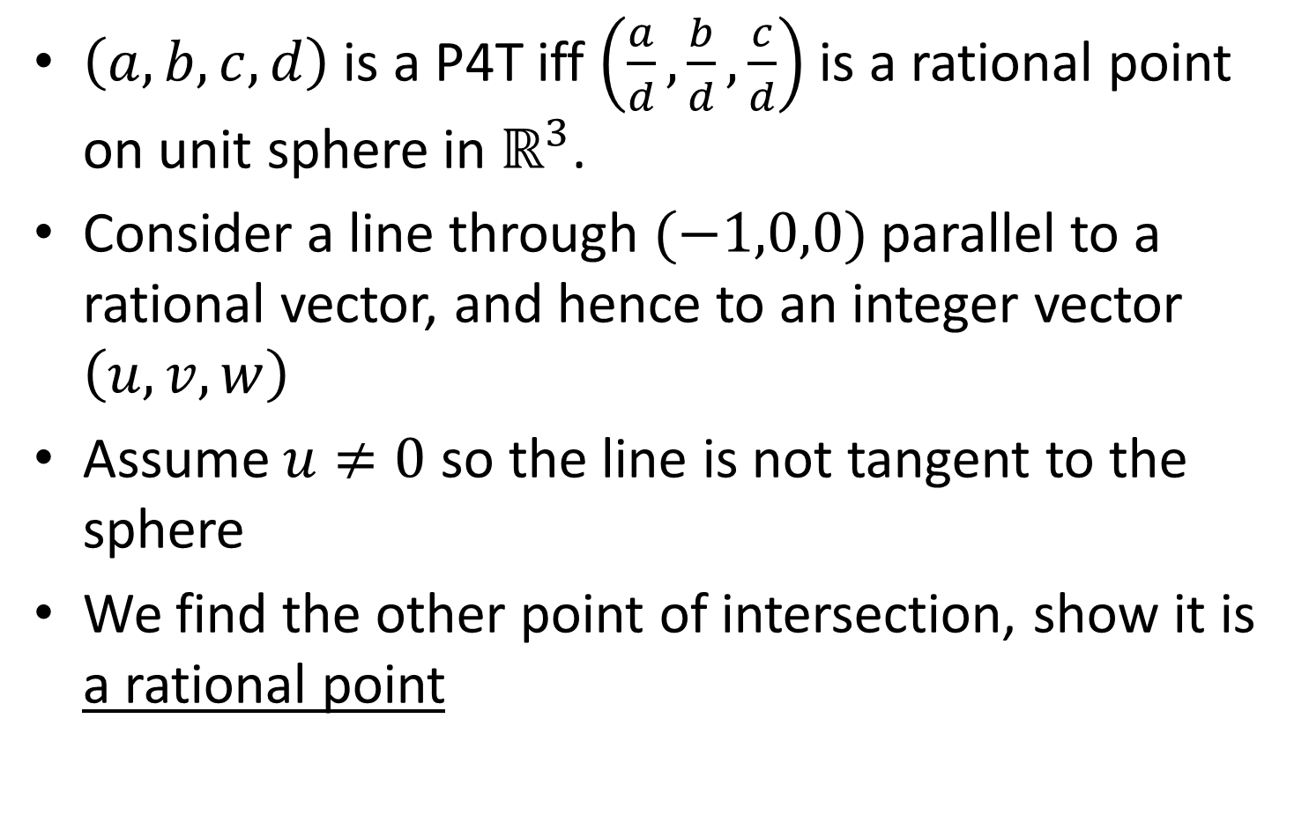
Three Dimensional Case
$\left(a,b,c,d\right)$ is a P4T iff $\left(\frac{a}{d},\frac{b}{d},\frac{c}{d}\right)$ is a rational point on unit sphere in $ℝ^{3}$.
Consider a line through $(−1,0,0)$ parallel to a rational vector, and hence to an integer vector $\left(u,v,w\right)$
Assume $u≠0$ so the line is not tangent to the sphere
We find the other point of intersection, show it is a rational point

Slide 7
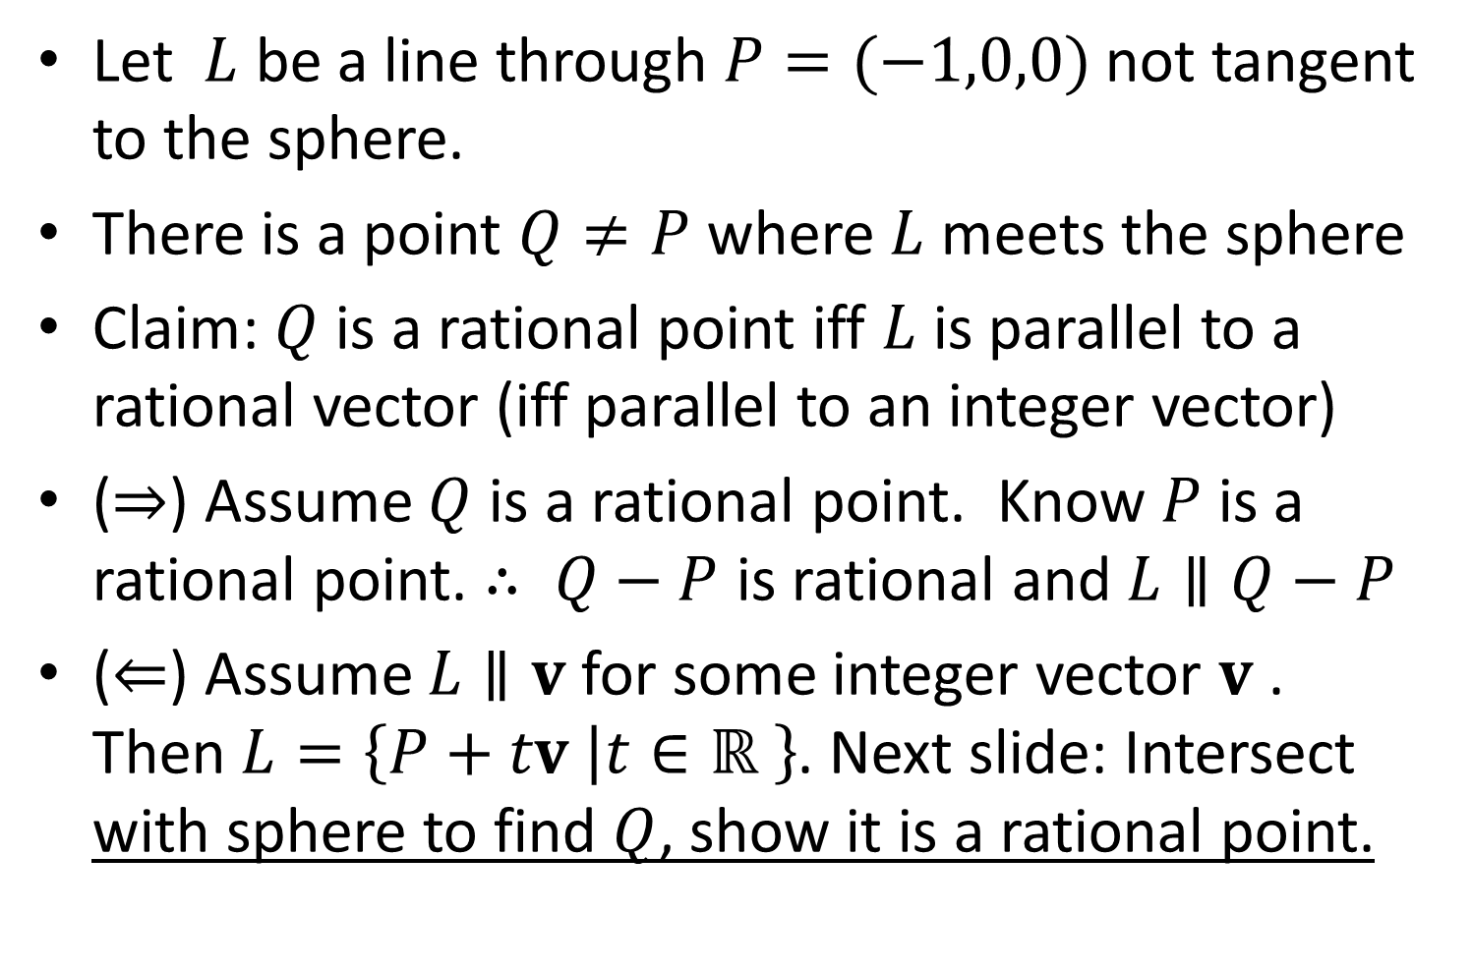
Key Equivalence
Let $L$ be a line through $P=(−1,0,0)$ not tangent to the sphere.
There is a point $Q≠P$ where $L$ meets the sphere
Claim: $Q$ is a rational point iff $L$ is parallel to a rational vector (iff parallel to an integer vector)
($⇒$) Assume $Q$ is a rational point. Know $P$ is a rational point. $∴ Q−P$ is rational and $L∥Q−P$
($⇐$) Assume $L∥v$ for some integer vector $v$. Then $L=\left\{P+tv \left|t∈ℝ\right. \right\}$. Next slide: Intersect with sphere to find $Q$, show it is a rational point.

Slide 8
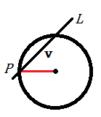
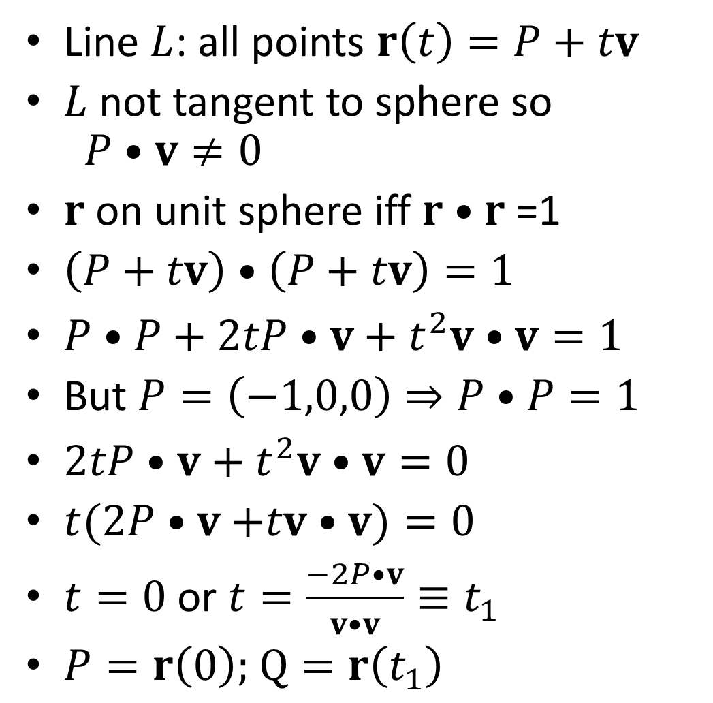

Solving for $Q$
Line $L$: all points $r\left(t\right)=P+tv$
$L$ not tangent to sphere so
$P•v≠0$
$r$ on unit sphere iff $r•r$ =1
$\left(P+tv\right)•\left(P+tv\right)=1$
$P•P+2tP•v+t^{2}v•v=1$
But $P=\left(−1,0,0\right)⇒P•P=1$
$2tP•v+t^{2}v•v=0$
$t(2P•v$ $+tv•v)=0$
$t=0$ or $t=\frac{−2P•v}{v•v}≡t_{1}$
$P=r\left(0\right);$ $Q=r\left(t_{1}\right)$

Slide 9
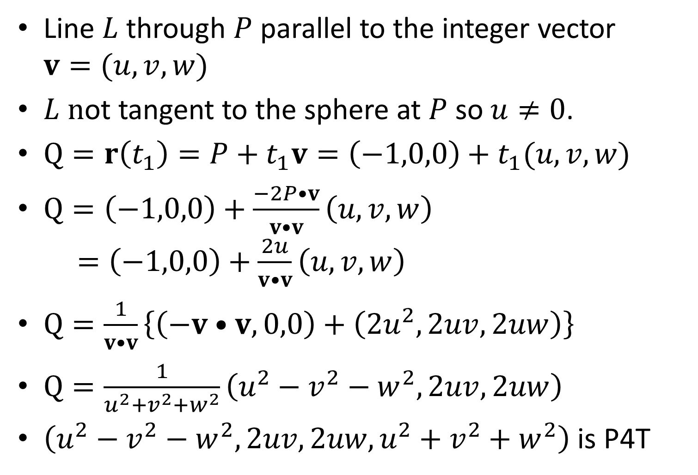
Finding Rational Points
Line $L$ through $P$ parallel to the integer vector $v=(u,v,w)$
$L n$ot tangent to the sphere at $P$ so $u≠0$.
$Q=r\left(t_{1}\right)=P+t_{1}v=\left(−1,0,0\right)+t_{1}(u,v,w)$
$Q=\left(−1,0,0\right)+\frac{−2P•v}{v•v}\left(u,v,w\right)$
$=\left(−1,0,0\right)+\frac{2u}{v•v}\left(u,v,w\right)$
$Q=\frac{1}{v•v}\left\{\left(−v•v,0,0\right)+\left(2u^{2},2uv,2uw\right)\right\}$
$Q=\frac{1}{u^{2}+v^{2}+w^{2}}\left(u^{2}−v^{2}−w^{2},2uv,2uw\right)$
$\left(u^{2}−v^{2}−w^{2},2uv,2uw,u^{2}+v^{2}+w^{2}\right)$ is P4T

Slide 10
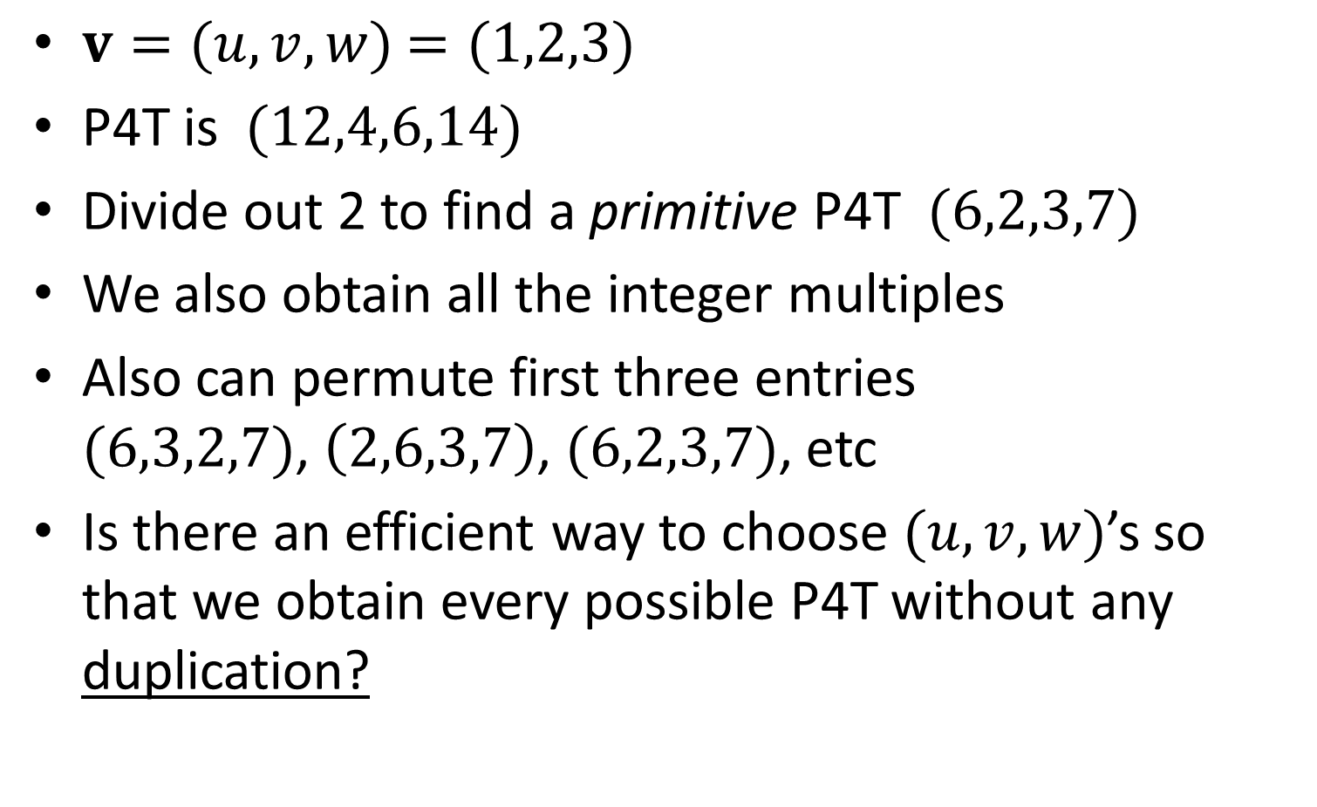
Example
$v=(u,v,w)$ $=(1,2,3)$
P4T is $(12,4,6,14)$
Divide out 2 to find a primitive P4T $(6,2,3,7)$
We also obtain all the integer multiples
Also can permute first three entries
$(6,3,2,7)$, $\left(2,6,3,7\right)$, $(6,2,3,7)$, etc
Is there an efficient way to choose $(u,v,w)$’s so that we obtain every possible P4T without any duplication?

Slide 11
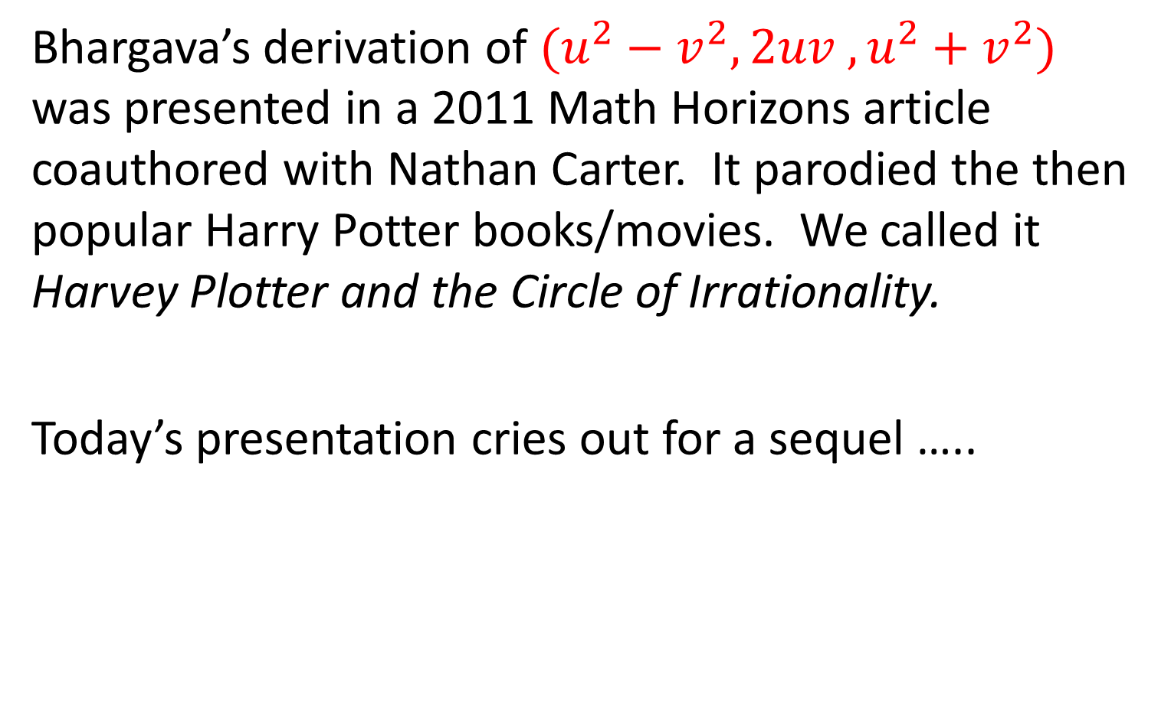
As some of you may know …
Bhargava’s derivation of $(u^{2}−v^{2}, 2uv ,u^{2}+v^{2})$ was presented in a 2011 Math Horizons article coauthored with Nathan Carter. It parodied the then popular Harry Potter books/movies. We called it Harvey Plotter and the Circle of Irrationality.
Today’s presentation cries out for a sequel …..

Slide 12
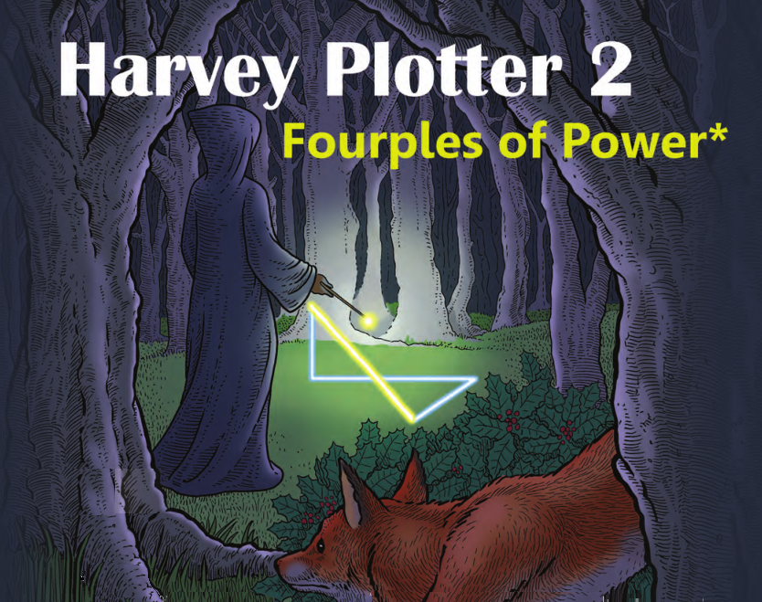

Slide 13
STOP

