Slide 1
Some Properties of Currie’s Curious Function
Dan Kalman (www.dankalman.net)
Joint work with Mel Currie
Preprint available
NOTE: Mel didn’t name the function after himself – that was my doing.

Slide 2
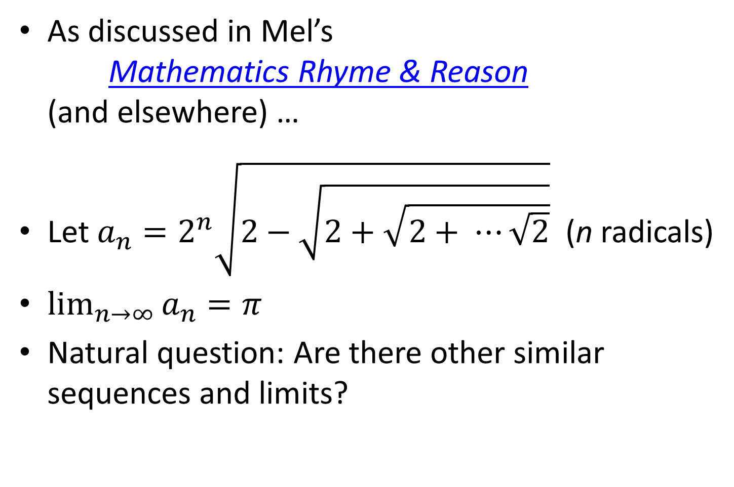
Background
As discussed in Mel’s
Mathematics Rhyme & Reason
(and elsewhere) …
Let $a_{n}=2^{n}\sqrt{2−\sqrt{2+\sqrt{2+ ⋯\sqrt{2}}}}$ (n radicals)
$\lim_{n→∞}{a_{n}=π}$
Natural question: Are there other similar sequences and limits?

Slide 3
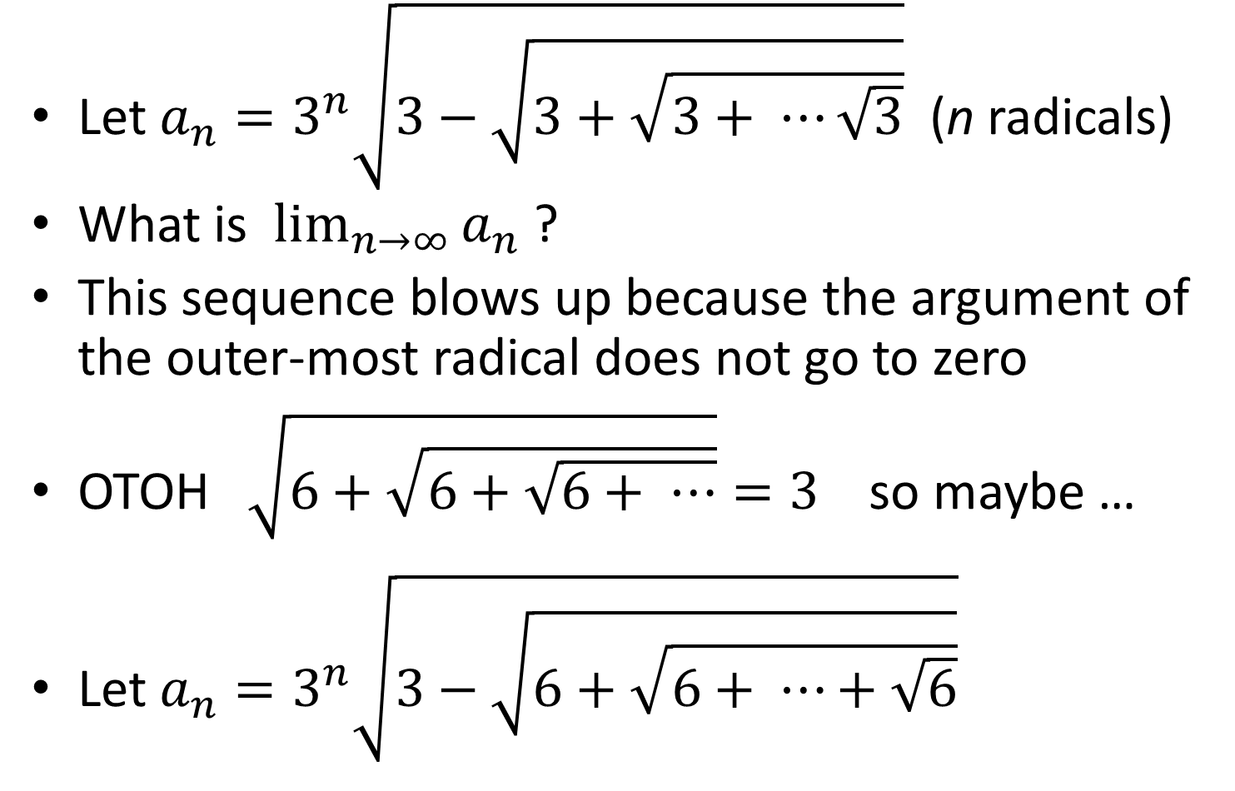
Obvious Example
Let $a_{n}=3^{n}\sqrt{3−\sqrt{3+\sqrt{3+ ⋯\sqrt{3}}}}$ (n radicals)
What is $\lim_{n→∞}{a_{n}}$ ?
This sequence blows up because the argument of the outer-most radical does not go to zero
OTOH $\sqrt{6+\sqrt{6+\sqrt{6+ ⋯}}}=3$ so maybe …
Let ${a_{n}=3}^{n}\sqrt{3−\sqrt{6+\sqrt{6+ ⋯+\sqrt{6}}}}$

Slide 4
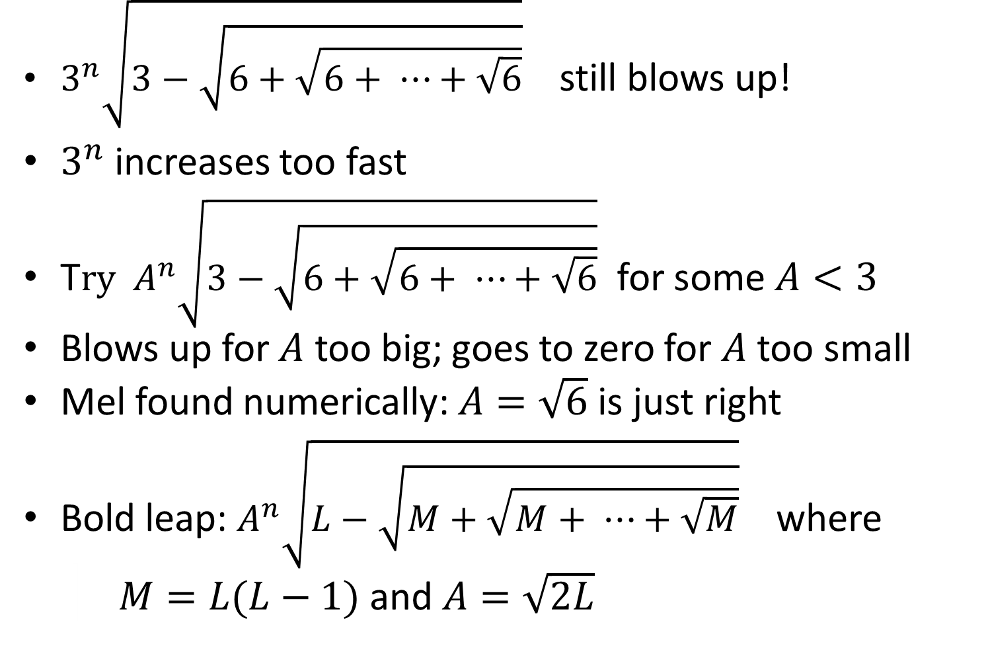
Less Obvious Example
$3^{n}\sqrt{3−\sqrt{6+\sqrt{6+ ⋯+\sqrt{6}}}}$ still blows up!
$3^{n}$ increases too fast
T$ry A^{n}\sqrt{3−\sqrt{6+\sqrt{6+ ⋯+\sqrt{6}}}}$ for some $A<3$
Blows up for $A$ too big; goes to zero for $A$ too small
Mel found numerically: $A=\sqrt{6}$ is just right
Bold leap: $A^{n}\sqrt{L−\sqrt{M+\sqrt{M+ ⋯+\sqrt{M}}}}$ where
| $M=L(L−1)$ and $A=\sqrt{2L}$

Slide 5
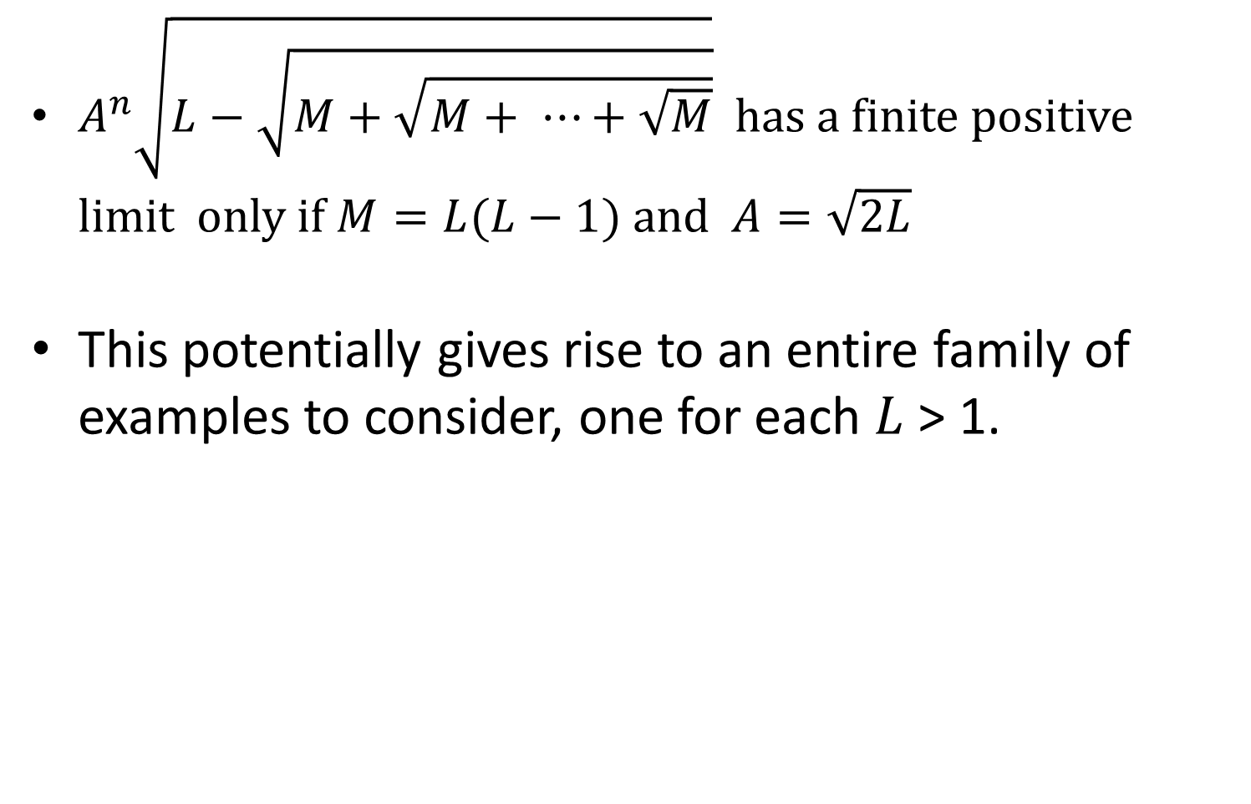
Necessary Condition
$A^{n}\sqrt{L−\sqrt{M+\sqrt{M+ ⋯+\sqrt{M}}}}$ has a finite positive limit only if $M=L(L−1)$ and $A=\sqrt{2L}$
This potentially gives rise to an entire family of examples to consider, one for each $L$ > 1.

Slide 6
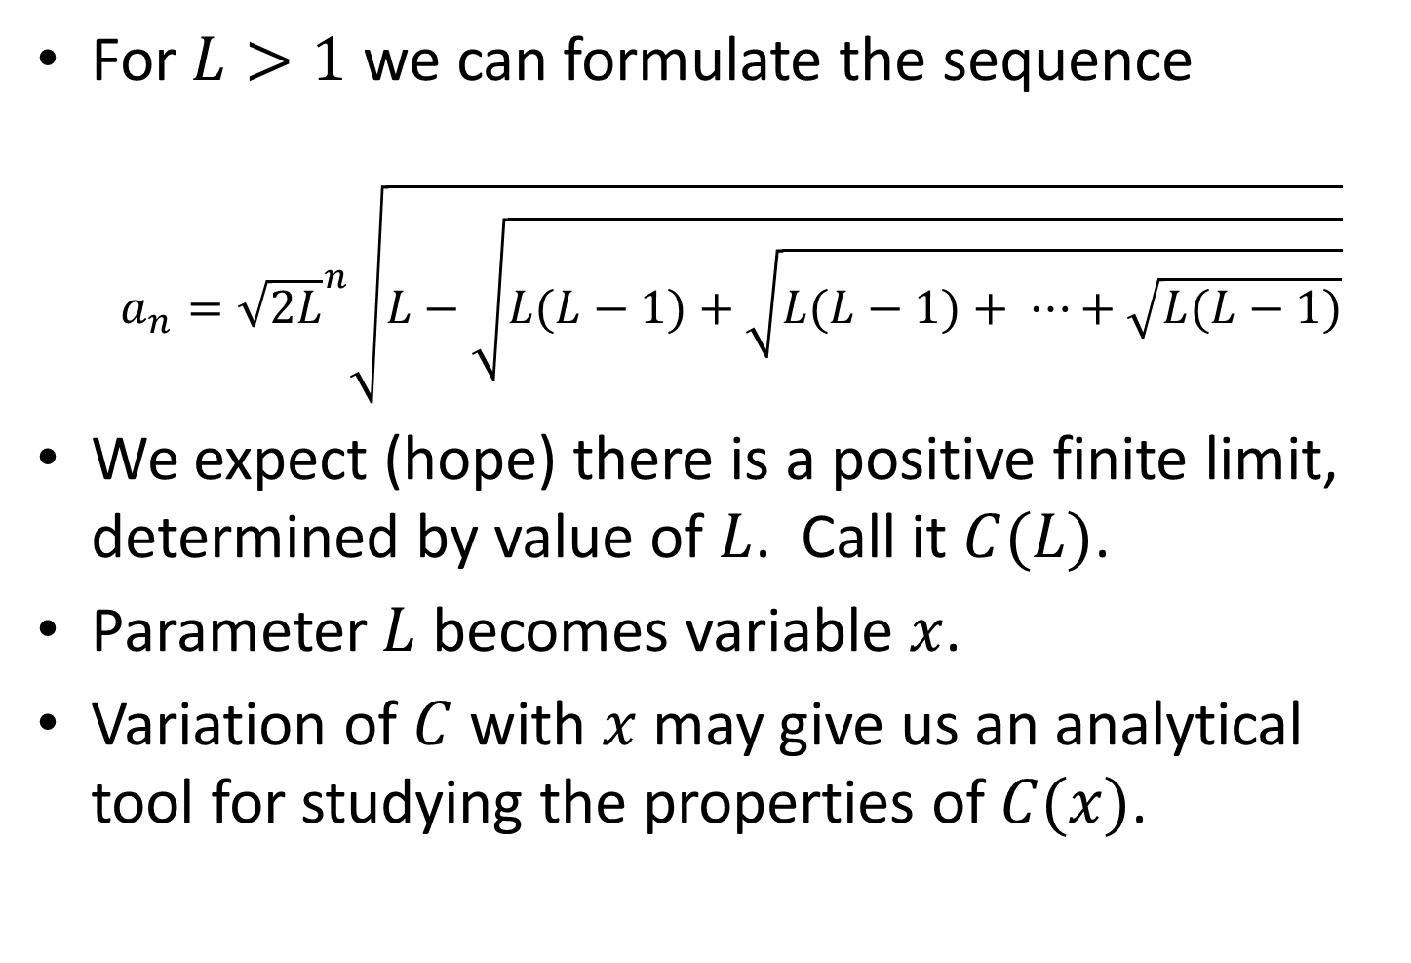
Currie’s Curious Function
For $L>1$ we can formulate the sequence
${a_{n}=\sqrt{2L}}^{n}\sqrt{L−\sqrt{L(L−1)+\sqrt{L(L−1)+ ⋯+\sqrt{L(L−1)}}}}$
We expect (hope) there is a positive finite limit, determined by value of $L$. Call it $C(L)$.
Parameter $L$ becomes variable $x$.
Variation of $C$ with $x$ may give us an analytical tool for studying the properties of $C(x)$.

Slide 7
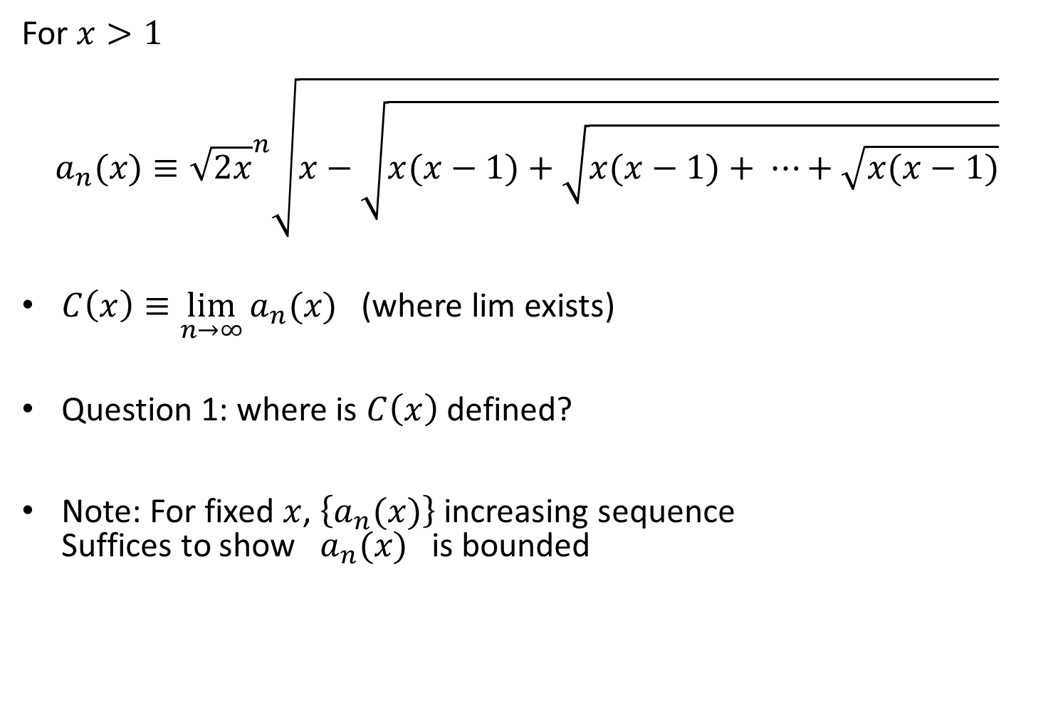
Definitions
For $x>1$
$${a_{n}(x)≡\sqrt{2x}}^{n}\sqrt{x−\sqrt{x(x−1)+\sqrt{x(x−1)+ ⋯+\sqrt{x(x−1)}}}}$$
$C\left(x\right)≡\lim_{n→∞}{a_{n}(x)}$ (where lim exists)
Question 1: where is $C\left(x\right)$ defined?
Note: For fixed $x$, $\left\{a_{n}(x)\right\}$ increasing sequence
Suffices to show $a_{n}(x)$ is bounded

Slide 8
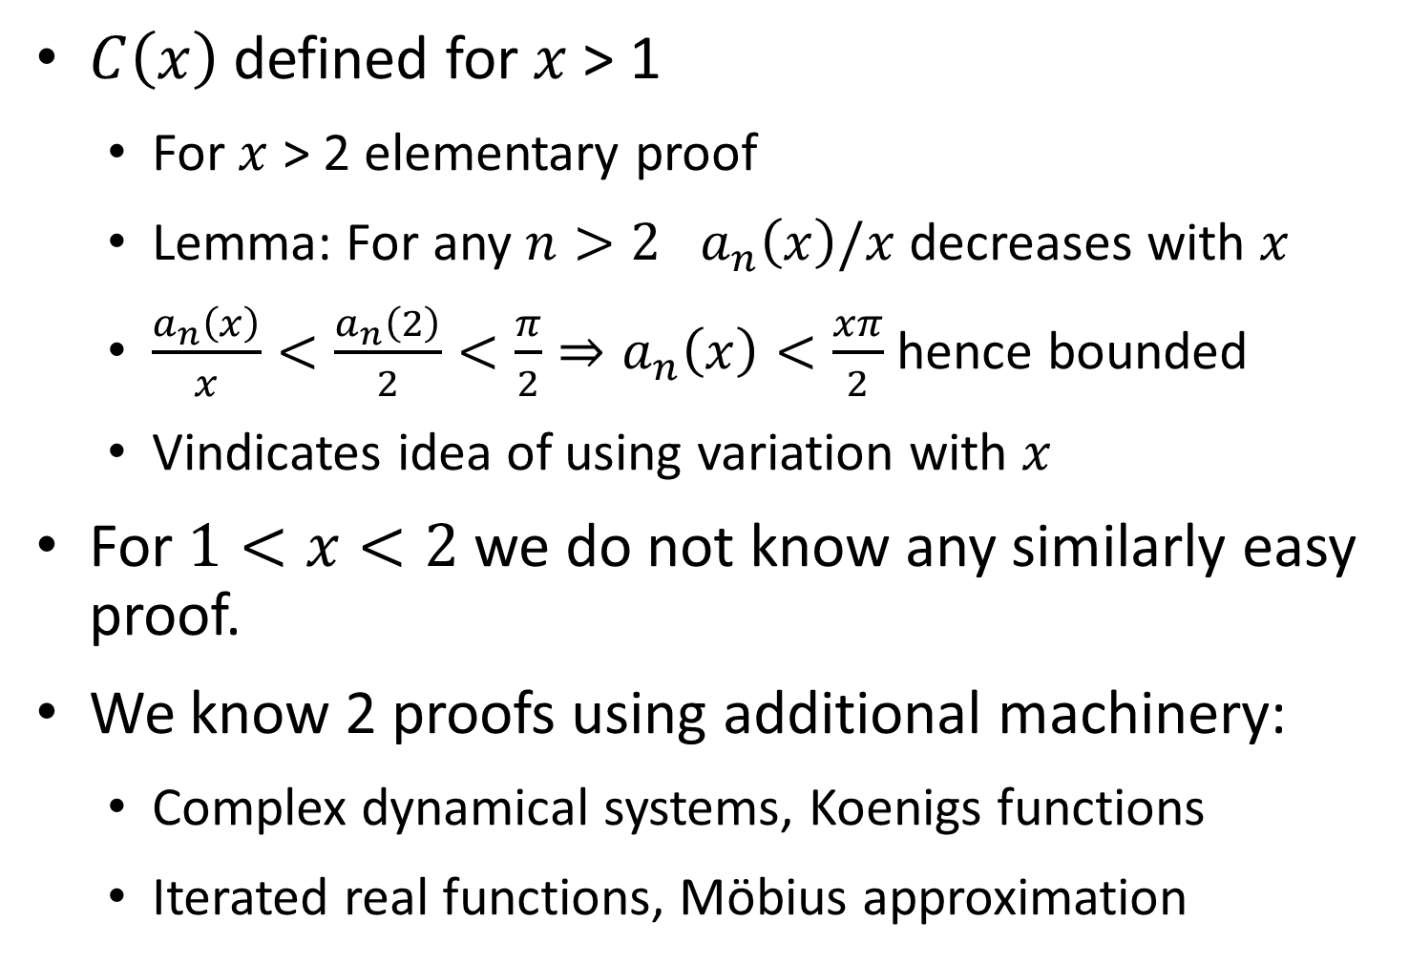
Convergence
$C\left(x\right)$ defined for $x$ > 1
  For $x$ > 2 elementary proof
  Lemma: For any $n>2$ $a_{n}\left(x\right)/x$ decreases with $x$
  $\frac{a_{n}\left(x\right)}{x}<\frac{a_{n}\left(2\right)}{2}<\frac{π}{2}⇒a_{n}\left(x\right)<\frac{xπ}{2}$ hence bounded
  Vindicates idea of using variation with $x$
For $1<x<2$ we do not know any similarly easy proof.
We know 2 proofs using additional machinery:
  Complex dynamical systems, Koenigs functions
  Iterated real functions, Möbius approximation

Slide 9
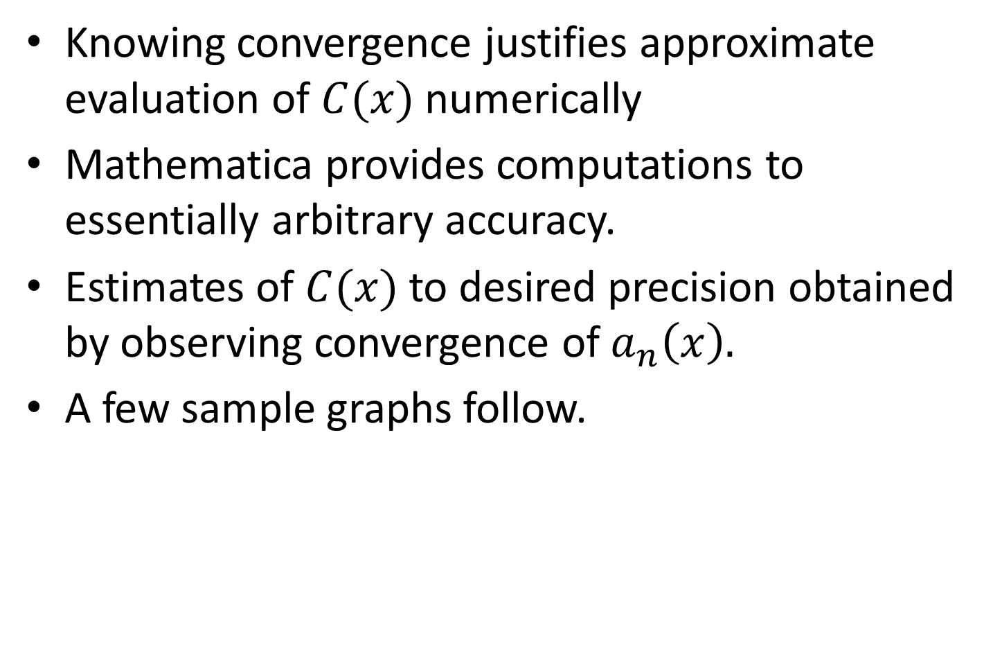
Graphical Features
Knowing convergence justifies approximate evaluation of $C(x)$ numerically
Mathematica provides computations to essentially arbitrary accuracy.
Estimates of $C(x)$ to desired precision obtained by observing convergence of $a_{n}\left(x\right).$
A few sample graphs follow.

Slide 10
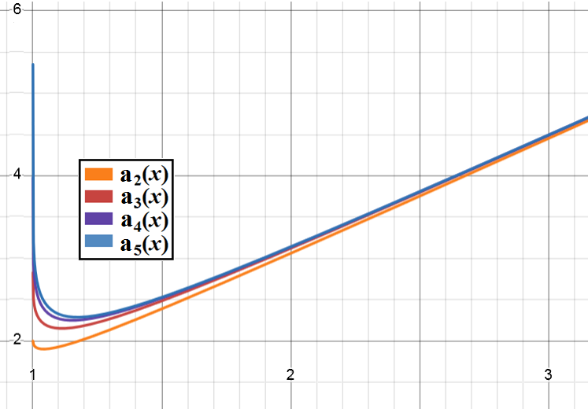

Slide 11
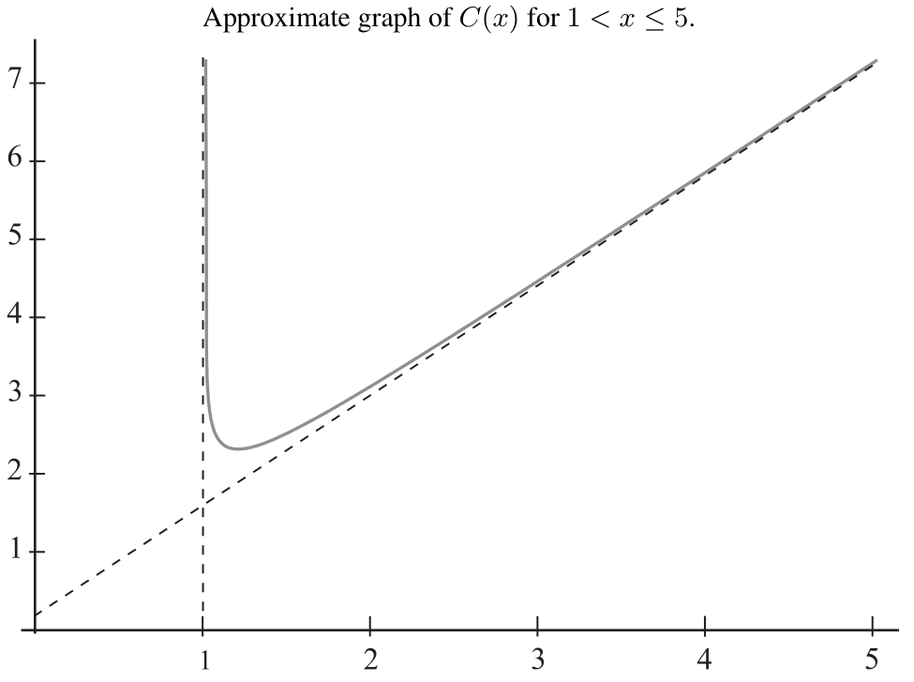

Slide 12
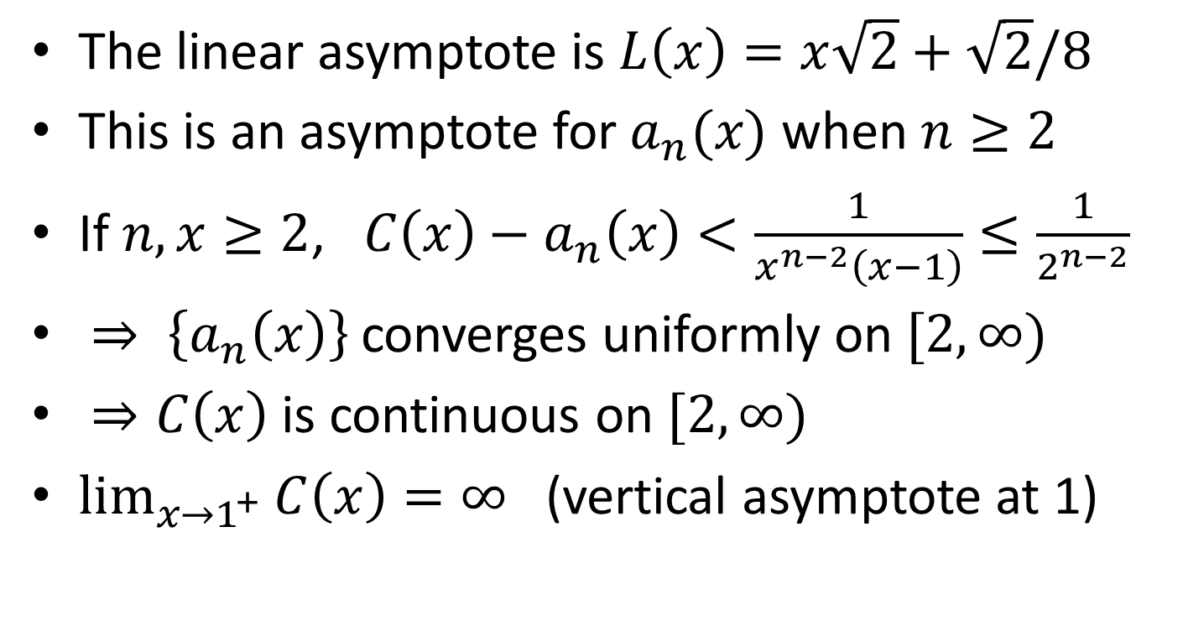
Things We Can Prove
The linear asymptote is $L\left(x\right)=x\sqrt{2}+\sqrt{2}/8$
This is an asymptote for $a_{n}(x)$ when $n≥2$
If $n, x≥2$,$C\left(x\right)−a_{n}\left(x\right)<\frac{1}{x^{n−2}\left(x−1\right)}≤\frac{1}{2^{n−2}}$
$⇒ \left\{a_{n}\left(x\right)\right\}$ converges uniformly on $[2,∞)$
$⇒C\left(x\right)$ is continuous on $[2,∞)$
$\lim_{x→1^{+}}{C\left(x\right)=∞}$ (vertical asymptote at 1)

Slide 13
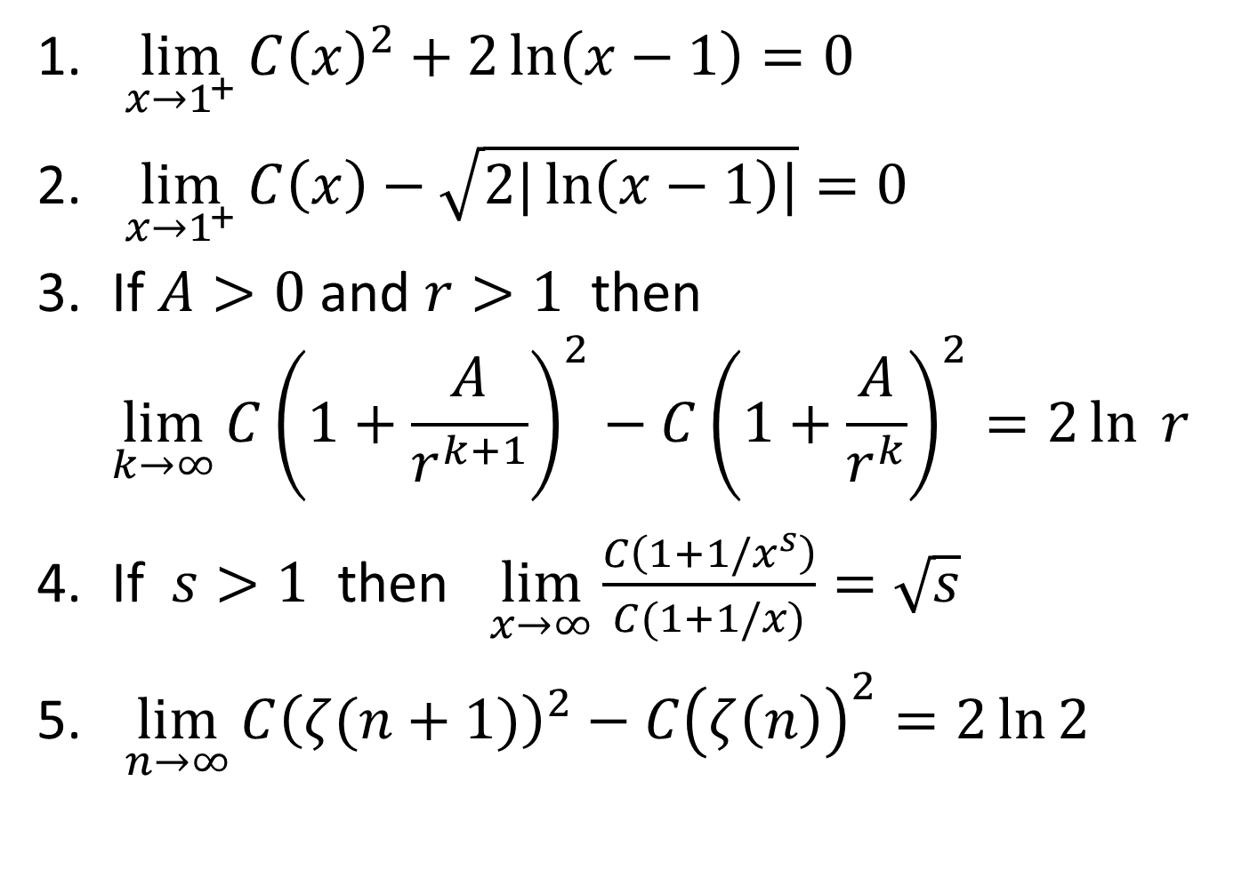
Conjectures
$\lim_{x→1^{+}}{C{\left(x\right)}^{2}+2\ln\left(x−1\right)=0}$
$\lim_{x→1^{+}}{C\left(x\right)−\sqrt{2|\ln\left(x−1\right)|}}=0$
If $A>0$ and $r>1$ then
$\lim_{k→∞}{C{\left(1+\frac{A}{r^{k+1}}\right)}^{2}−C{\left(1+\frac{A}{r^{k}}\right)}^{2}=2\ln{ r}}$
If $s>1$ then $\lim_{x→∞}{\frac{C\left(1+1/x^{s}\right)}{C(1+1/x)}=\sqrt{s}}$
$\lim_{n→∞}{C{\left(ζ(n+1)\right)}^{2}−C{\left(ζ\left(n\right)\right)}^{2}=2\ln{2}}$

Slide 14
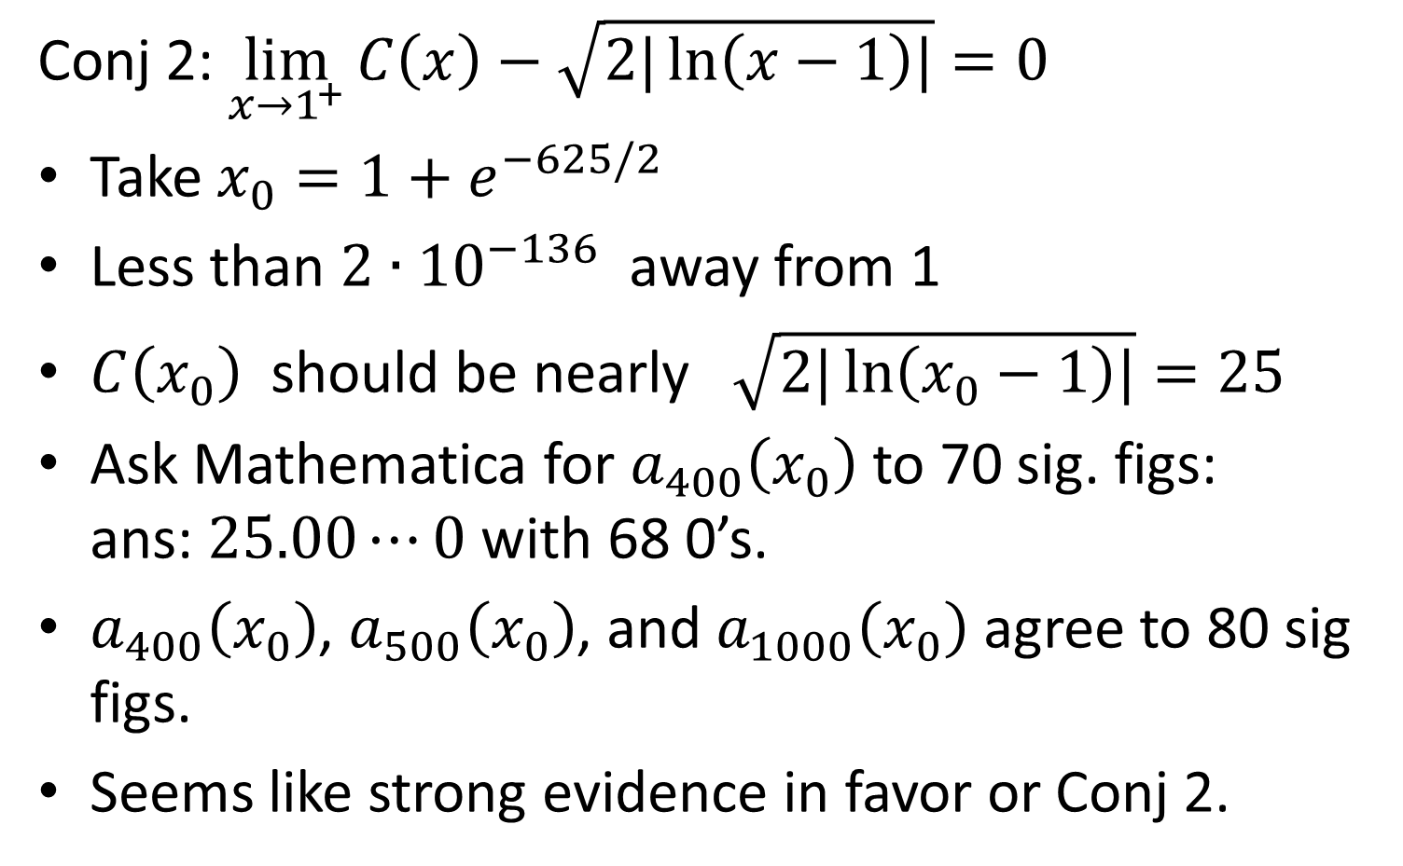
Numerical Evidence Example
Conj 2: $\lim_{x→1^{+}}{C\left(x\right)−\sqrt{2|\ln\left(x−1\right)|}}=0$
Take $x_{0}=1+e^{−625/2}$
Less than $2∙{10}^{−136}$ away from 1
$C\left(x_{0}\right)$ should be nearly $\sqrt{2|\ln\left(x_{0}−1\right)|}=25$
Ask Mathematica for $a_{400}\left(x_{0}\right)$ to 70 sig. figs:
ans: $25.00⋯0$ with 68 0’s.
$a_{400}\left(x_{0}\right)$, $a_{500}\left(x_{0}\right)$, and $a_{1000}\left(x_{0}\right)$ agree to 80 sig figs.
Seems like strong evidence in favor or Conj 2.

Slide 15
More Conjecture Info
Very persuasive numerical evidence for all
No idea how to prove any of them
We have proved that Conj 1 implies Conj’s 2, 3, and 4
We also have the following compound conjecture.
Conjecture 6: Conj 3 implies Conj 5.
If so, then proving Conj 1 will establish 2 -- 5

Slide 16
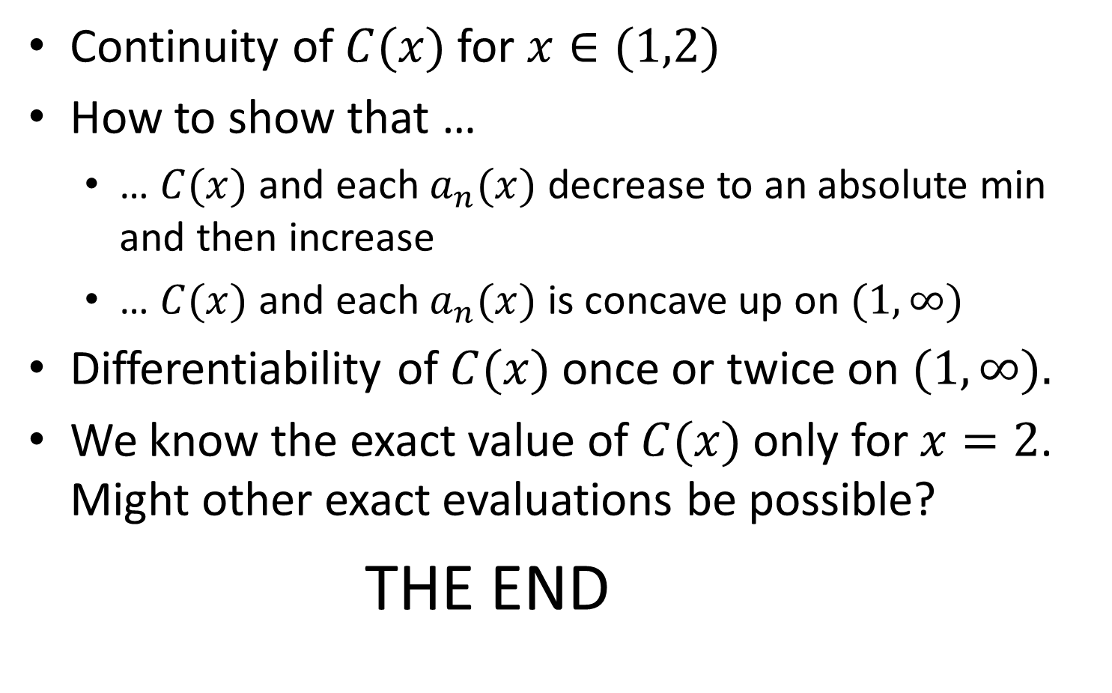
More Reasons to be Curious
Continuity of $C(x)$ for $x∈(1,2)$
How to show that …
  … $C(x)$ and each $a_{n}(x)$ decrease to an absolute min and then increase
  … $C(x)$ and each $a_{n}(x)$ is concave up on $(1,∞)$
Differentiability of $C(x)$ once or twice on $(1,∞)$.
We know the exact value of $C(x)$ only for $x=2$. Might other exact evaluations be possible?
THE END

