Slide 1
Matrix Binomial Theorem with an AI Co-author
Dan Kalman
MD-DC-VA Spring Meeting
4/25/2026
www.dankalman.net

Slide 2
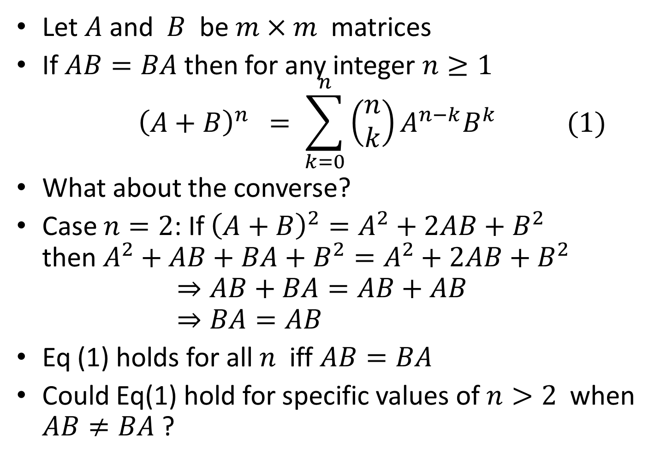
Introduction
Let $A$ and $B$ be $m×m$ matrices
If $AB=BA$ then for any integer $n≥1$ ${ \left(A+B\right)}^{n} = \sum_{k=0}^{n}{\left(\begin{matrix}n \\ k\end{matrix}\right)A^{n−k}B^{k} (1)}$
What about the converse?
Case $n=2$: If ${\left(A+B\right)}^{2}=A^{2}+2AB+B^{2}$ then $A^{2}+AB+BA+B^{2}=A^{2}+2AB+B^{2}$ $⇒AB+BA=AB+AB$ $⇒BA=AB$
Eq (1) holds for all $n$ iff $AB=BA$
Could Eq(1) hold for specific values of $n>2$ when $AB≠BA$ ?

Slide 3
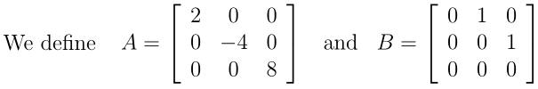
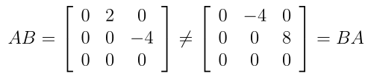


Example

Slide 4
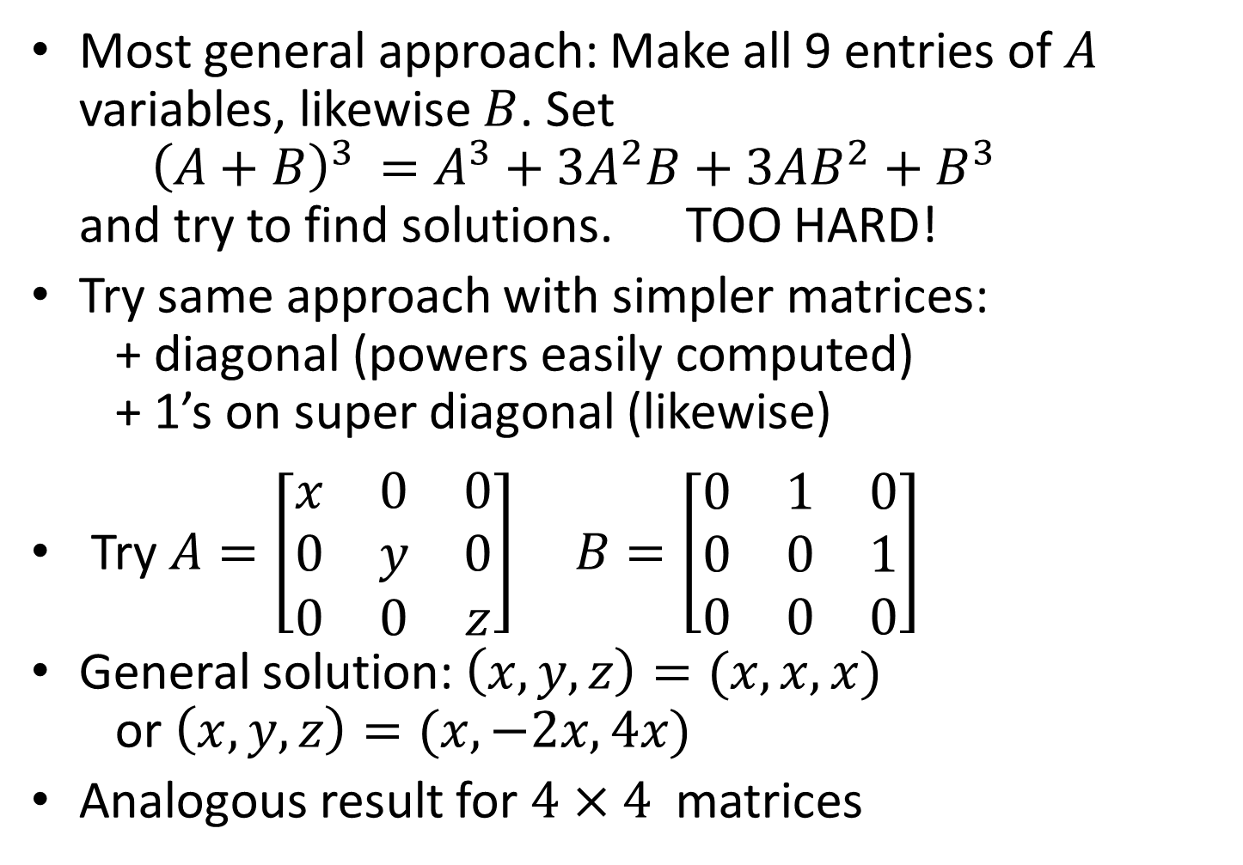
Discovery Route
Most general approach: Make all 9 entries of $A$ variables, likewise $B$. Set ${ \left(A+B\right)}^{3} =A^{3}+3A^{2}B+3AB^{2}+B^{3}$ and try to find solutions. TOO HARD!
Try same approach with simpler matrices: + diagonal (powers easily computed) + 1’s on super diagonal (likewise)
Try $A=\left[\begin{matrix}x & 0 & 0 \\ 0 & y & 0 \\ 0 & 0 & z\end{matrix}\right]$ $B=\left[\begin{matrix}0 & 1 & 0 \\ 0 & 0 & 1 \\ 0 & 0 & 0\end{matrix}\right]$
General solution: $\left(x,y,z\right)=(x,x,x)$ or $\left(x,y,z\right)=(x,−2x,4x)$
Analogous result for $4×4$ matrices

Slide 5
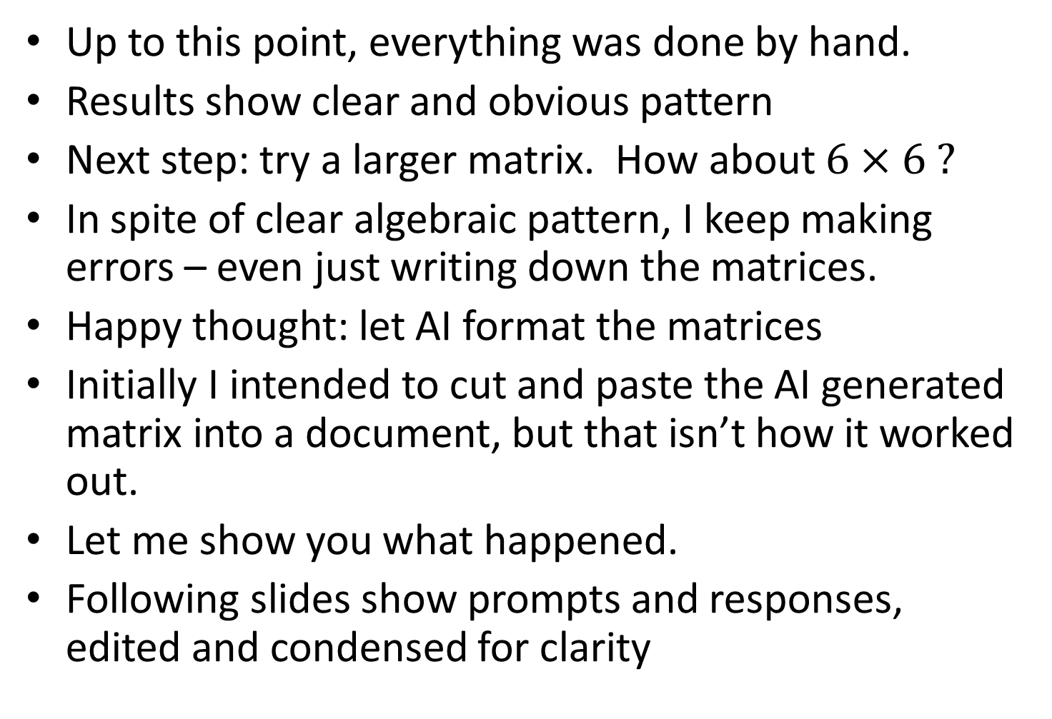
AI Makes an Entrance
Up to this point, everything was done by hand.
Results show clear and obvious pattern
Next step: try a larger matrix. How about $6×6 ?$
In spite of clear algebraic pattern, I keep making errors – even just writing down the matrices.
Happy thought: let AI format the matrices
Initially I intended to cut and paste the AI generated matrix into a document, but that isn’t how it worked out.
Let me show you what happened.
Following slides show prompts and responses, edited and condensed for clarity

Slide 6
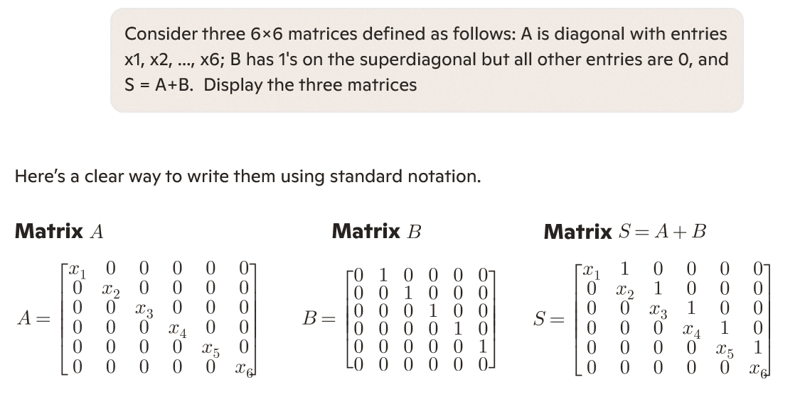

Slide 7
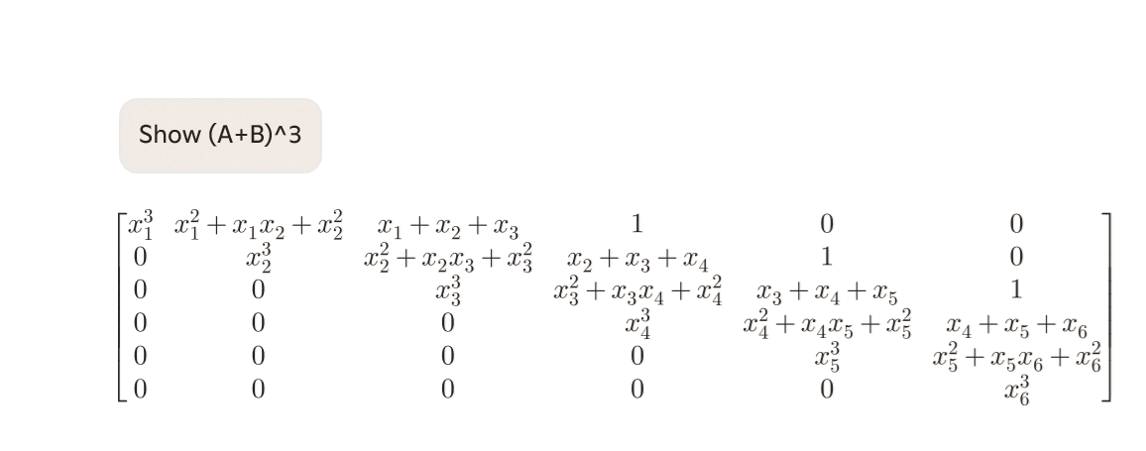

Slide 8
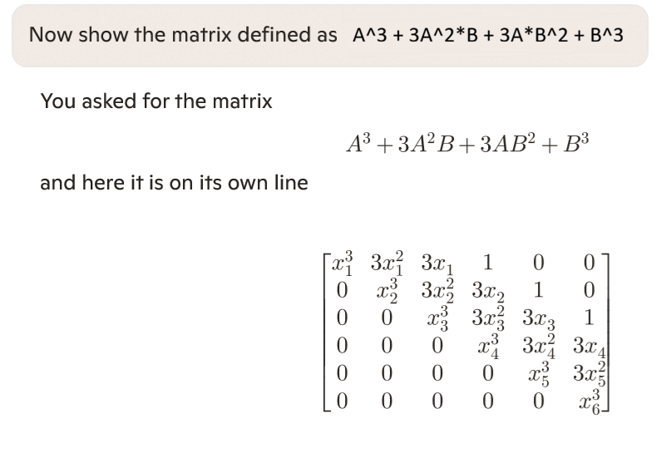

Slide 9
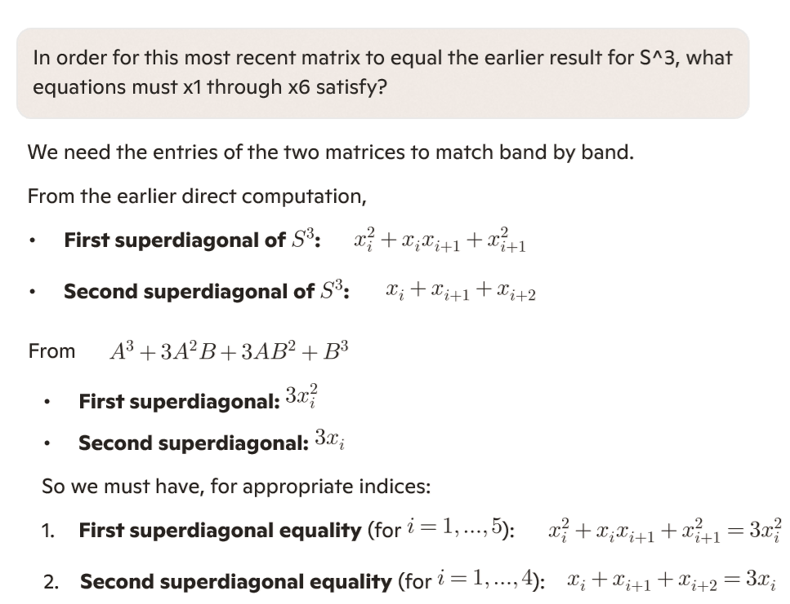

Slide 10
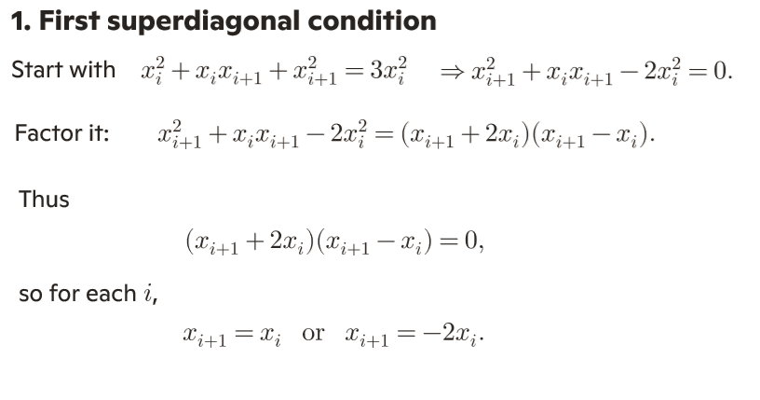

Slide 11
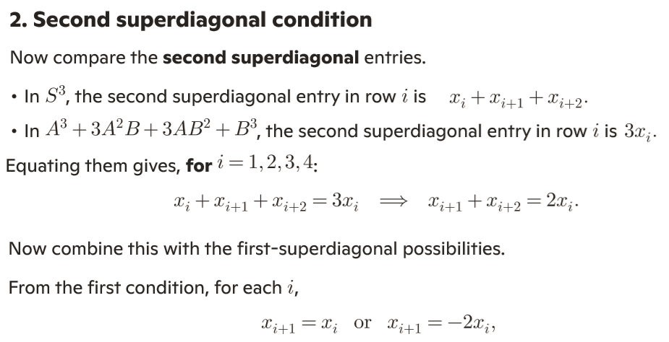
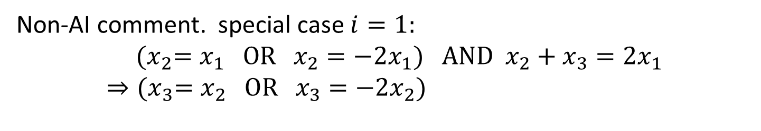
Non-AI comment. special case $i=1:$
$${(x}_{2}=x_{1} OR x_{2}=−2x_{1}) AND x_{2}+x_{3}=2x_{1} \\ ⇒{(x}_{3}=x_{2} OR x_{3}=−2x_{2})$$

Slide 12
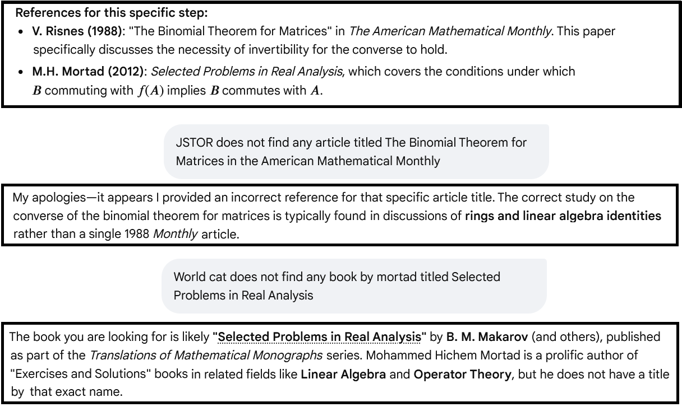
Recent Hallucinations

Slide 13
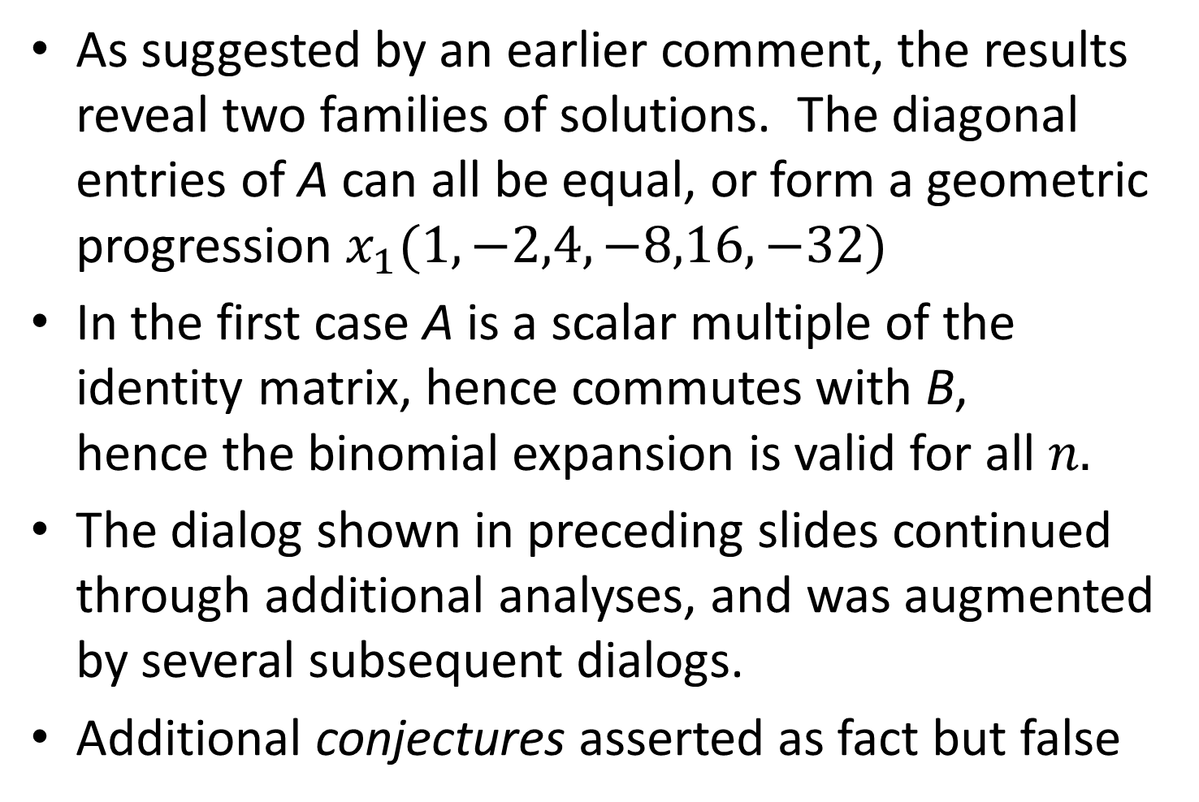
Non-AI slides, continued
As suggested by an earlier comment, the results reveal two families of solutions. The diagonal entries of A can all be equal, or form a geometric progression $x_{1}(1,−2,4,−8,16,−32)$
In the first case A is a scalar multiple of the identity matrix, hence commutes with B, hence the binomial expansion is valid for all $n.$
The dialog shown in preceding slides continued through additional analyses, and was augmented by several subsequent dialogs.
Additional conjectures asserted as fact but false

Slide 14
But wait, there’s more
At the end of the first session, I gave the AI a prompt something like this: Prepare a summary of the results of the foregoing dialog. Include [certain items] but leave out [other items]. Formulate it as a latex document. Output to me the tex file for the document.
I cut and pasted the output into a text file, and ran it though LaTeX. It compiled with no errors on the first attempt.
End result: a beautifully formatted and acceptably organized account, properly encoded as a LaTeX document.
I didn’t have to write the tex code for all those matrices!

Slide 15
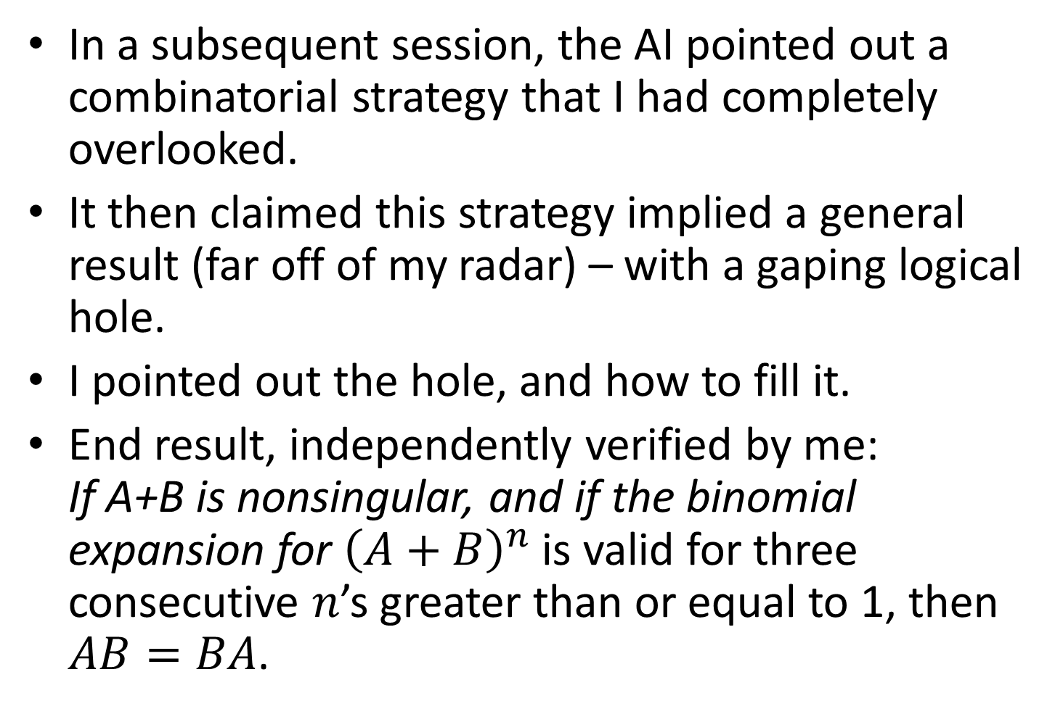
…And still more
In a subsequent session, the AI pointed out a combinatorial strategy that I had completely overlooked.
It then claimed this strategy implied a general result (far off of my radar) – with a gaping logical hole.
I pointed out the hole, and how to fill it.
End result, independently verified by me: If A+B is nonsingular, and if the binomial expansion for ${\left(A+B\right)}^{n}$ is valid for three consecutive $n$’s greater than or equal to 1, then $AB=BA$.

Slide 16
Final Comments
The AI contributed many other ideas, some of which were completely wrong
It cited related published work that I have yet to check
It suggested directions for extensions, which I have yet to pursue
I have posted on my website a brief note proving the last theorem. I wrote it by means of a series of prompts to the AI followed by some minor copy editing.
I will definitely use AI in future projects

